Slide 1
Working With Text Data
Hilary Mason
@hmason
h@bit.ly

Slide 2

Notes:
Data in -> Data processed -> Data out

Slide 3

Notes:
A bit of a fish out of water… we’ll discuss at levels for all people in the room today (newbies to experts)

Slide 4
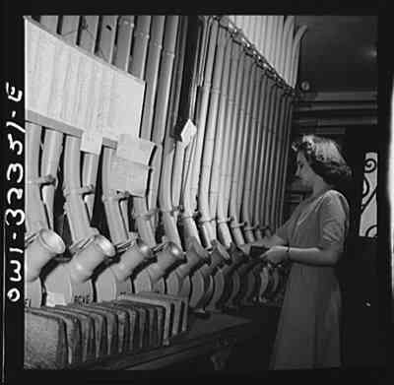
Notes:
Acquiring data
http://io9.com

Slide 5
Data Sources
Files
Database
Document store
API
Crawling
Streaming data

Slide 6

http://oreilly.com/catalog/0636920018254

Slide 7
Getting data from the web.

Slide 8

curl http://strataconf.com/strata2011/public/schedule/detail/17164
curl -o bootcamp.html http://strataconf.com/strata2011/public/schedule/detail/17164
curl --head http://bit.ly/feWn2O

Slide 9
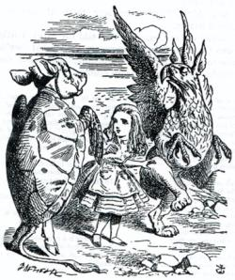
BeautifulSoup
Parse messy HTML and XML, easily.
http://www.crummy.com/software/BeautifulSoup/

Slide 10
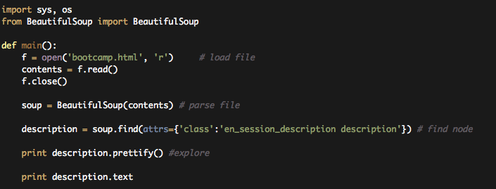
strata_bootcamp/code/text_data/content_parsing

Slide 11


Slide 12
lynx –dump http://strataconf.com/strata2011/public/schedule/detail/17164

Slide 13
Content Extraction

Slide 14
E-mail.

Slide 15
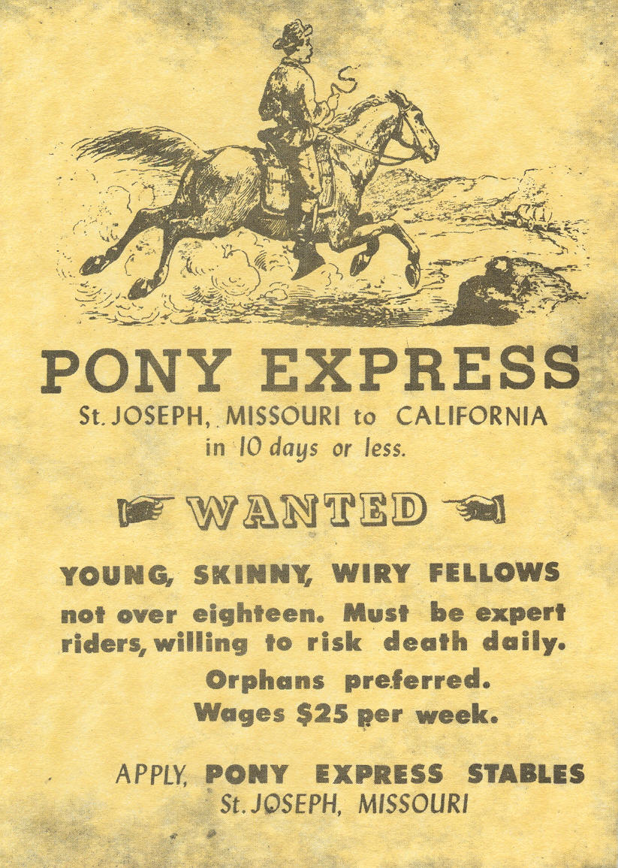

Slide 16
POP
IMAP
??
Sucks the least.

Slide 17
inbox inventory
Folder [Gmail]/Starred, # messages: 0
Folder INBOX, # messages: 7
Folder [Gmail]/All Mail, # messages: 28
Folder bacn, # messages: 3
Folder Personal, # messages: 0
Folder Travel, # messages: 0
Folder Work, # messages: 0
Folder commercial, # messages: 8
Folder [Gmail]/Drafts, # messages: 0
Folder waiting, # messages: 1
Folder [Gmail]/Spam, # messages: 39
Folder inbox, # messages: 7
Folder [Gmail]/Trash, # messages: 4
Folder [Gmail]/Sent Mail, # messages: 6
Folder [Gmail], # messages: 0
Folder friends, # messages: 7
Folder Receipts, # messages: 0

Slide 18
Get the code:
strata_bootcamp/code/text_data/email_analysis

Slide 19
E-mail graphs.

Slide 20

Classification

Slide 21
<math>

Slide 22
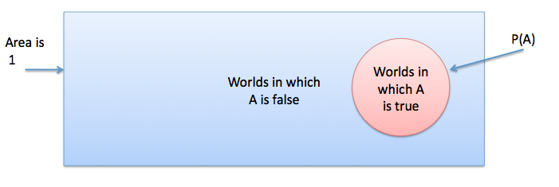
Probability
P(A) is the probability that A is true.
Notes:
P(A) is the fraction of possible universes in which A is true.

Slide 23
Axioms of Probability
P(True) = 1
P(False) = 0
0 ≤ P(A) ≤ 1
P(A or B) = P(A) + P(B) – P(A and B)

Slide 24
P(A or B) = P(A) + P(B) – P(A and B)
P(A)
P(A and B)
P(B)

Slide 25
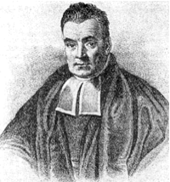
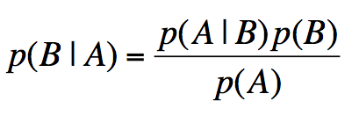
Bayes Law

Slide 26

Example
There are
10,000 people.
1% have a rare
disease.

Slide 27
Example
Population of 10,000
1% have rare disease
There’s a test that is 99% effective.
99% of sick patients test positive
99% of healthy patients test negative

Slide 28
Given a positive test result, what is the probability that the patient is sick?

Slide 29
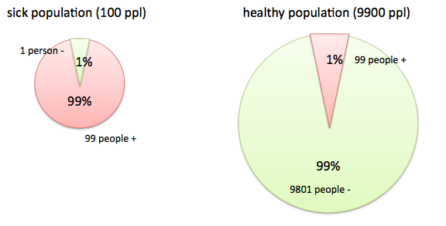

Slide 30
Disease Diagnosis
99 sick patients test positive, 99 healthy patients test positive
Given a positive test, there is a 50% probability that the patient is sick.

Slide 31
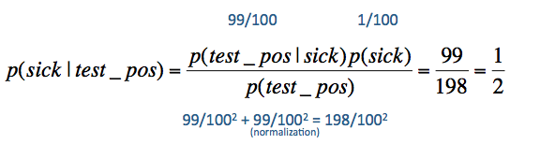
Bayesian Disease
Know the prob. of testing sick given healthy, and healthy given sick
Use Bayes theorem to invert probabilities

Slide 32
</math>

Slide 33

Notes:
Feature selection

Slide 34
What features work best for e-mail?

Slide 35
Clean data > More data > Fancier math

Slide 36

Thanks!

